Slide 1
DSC 530: EDA of Streaming Content Data Set
By Zach Quinn
DSC 530
Prof Williams
Bellevue University

Slide 2
Introduction
Video streaming market valued at 38.5 billion (2018), projected to reach 149 billion dollars by 2026 (Rake, Baul, 2019)
Netflix released nearly 400 original series in 2019 and relies heavily upon its robust library of licensed content (Bridge, 2019)
Subscriber data feeds machine learning recommendation algorithms to promote most-viewed and highly rated content (Netflix, 2020)
Unlike Nielsen ratings of broadcast T.V. age, streaming platforms reluctant to release user data to public/advertisers

Slide 3
Beginning EDA
Research question: Does the release year and runtime of a particular film selection have a significant impact on how it is rated and, therefore, promoted on Disney Plus, Hulu, Netflix and Amazon Prime?
Data set includes 17 columns with 16,744 unique values
Relevant variables:
Runtime
IMDB rating
Year
Rotten Tomatoes rating
Netflix (downloaded or not downloaded)

Slide 4
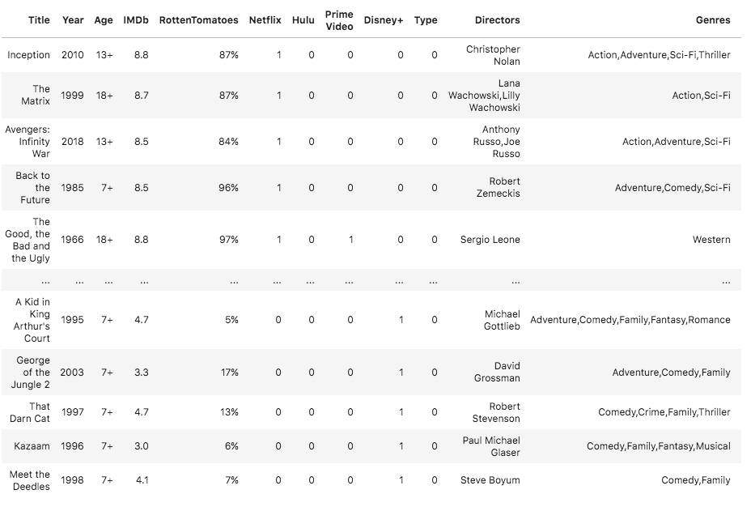
Cleaned data display

Slide 5
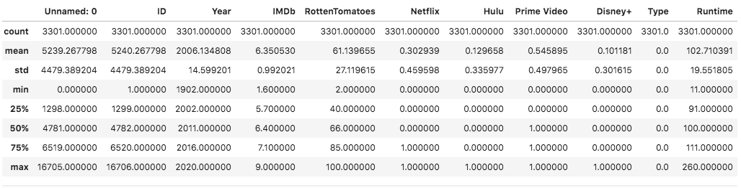
Descriptive Statistics

Slide 6
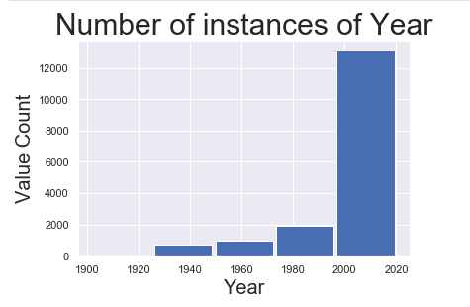
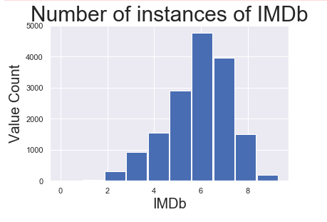
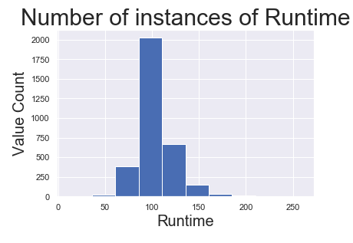
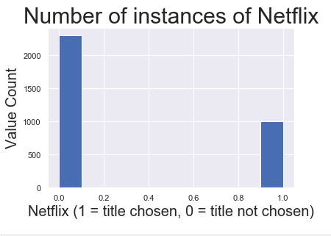
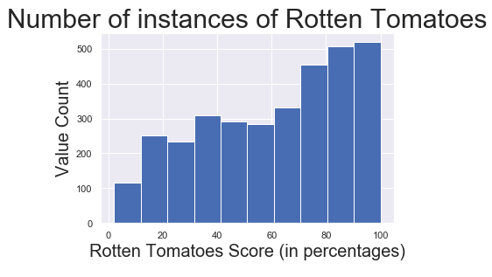
Histograms for variables

Slide 7
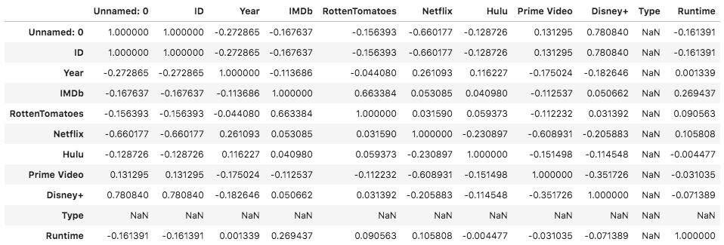
Correlation Matrix

Slide 8
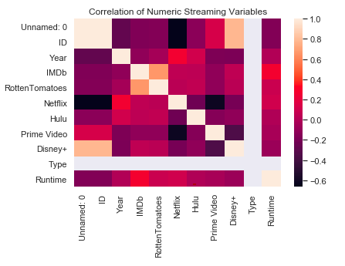
Correlation Test Heat Map

Slide 9
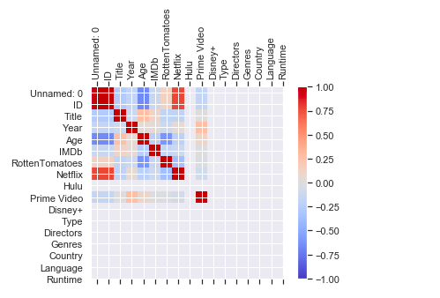
Correlation Plot (All Variables)

Slide 10
Linear Regression Model 1
80-20 train_test split of year ~ IMDB
Coefficient: -0.07
Intercept: 20.42
Score: 0.01
Accuracy: 1%
Result: Cannot sufficiently reject null hypothesis

Slide 11
Linear Regression Model 2
80-20 test_train split of Runtime ~ IMDB
Coefficient: 0.01
Intercept: 4.89
Score: 0.08
Accuracy: 8%
Result: Cannot sufficiently reject the null hypothesis for the model

Slide 12
Linear Regression Model 3
80-20 test_train split of Year ~ Rotten Tomatoes
Coefficient: -0.09
Intercept: 234.2
Score: 0.002
Accuracy: 0.002%
Result: Cannot reject null hypothesis

Slide 13
Results
Unable to reject null hypothesis on basis of insufficient correlation test and linear model
No significant correlation among variables: Year ~ IMDB, Runtime ~ IMDB or Year ~ Rotten Tomatoes
Hypothesis invalid: Year and runtime do not have a significant impact on how streaming content is rated and, consequently, promoted to subscribers

Slide 14
References
Bridge, G. (2019, December 18). Netflix Released More Originals in 2019 Than the Entire TV Industry Did in 2005. Retrieved May 30, 2020, from https://variety.com/2019/tv/news/netflix-more-2019-originals-than-entire-tv-industry-in-2005-1203441709/
Netflix. (2020). Netflix Research: Machine Learning. Retrieved May 30, 2020, from https://research.netflix.com/research-area/machine-learning
Rake, R., &amp; Baul, S. (2019, December). Video Streaming Market Size, Share and Growth Drivers Analysis - 2026. Retrieved May 30, 2020, from https://www.alliedmarketresearch.com/video-streaming-market

